Slide 1
Immunization schedules
By
Madadi Stanceline
Pauline Mumbo
Annette Okere

Slide 2
Introduction
The immunizable diseases include:
Tuberculosis - BCG vaccine,
Polio – Oral Polio Vaccine, IPV
Diphtheria – Diphtheria toxoid vaccine,
Whooping cough - whole cell Pertusis vaccine,
Tetanus - Tetanus toxoid vaccine,
Measles - Measles vaccine.
Yellow fever
Hepatitis B vaccine
Haemophilus Influenza type B vaccine (Hib)
Pneumococcal conjugate vaccine
Rotavirus vaccine

Slide 3
Contact | Vaccine dose | Types of vaccines | Age of child | Dosage | Route
1 | BCG OPV birth dose (trivalent) | Attenuated M.bovis Attenuated live, 1, 2,3 | At birth or at first contact At birth or first contact (within the first 2 weeks of life) | 0.05 ml infants, 0.1ml >1 yr 2 drops | Intradermal Oral
2 | OPV I DPT- Hep B+Hib 1 (pentavalent) PCV 10 -1 Rota |  | At 6 weeks of life or first contact | 2 drops 0.5 ml 0.5ml 1.5ml | Oral IM (upper outer left thigh) IM (upper outer right thigh) Oral
3 | OPV II DPt-Hepb+ Hib 2 PCV 10 -2 Rota |  | 10 weeks or 4 weeks after OPV I and DPT- HepB- Hib 1 | 2 drops 0.5ml 0.5ml 1.5ml | Oral IM outer aspect left thigh IM upper outer aspect right thigh Oral

Slide 4
4 | OPV III DPT- HepB+Hib 3 PCV 10 -3 |  | 14 wks or 4 wks after OPV II and DPT-HepB-Hib2 | 2 drops 0.5 ml 0.5ml | Oral IM upper aspect left thigh IM upper outer right thigh
5 | Vit A 100000 IU |  | 6mnths | One capsule | Orally
6 | Measles 1st dose |  | 9 months or 1st contact after 9 months | 0.5ml | Subcut (right upper arm)
7 | Yellow fever |  | 9 months/ 1st contact after 9months * | 0.5 ml | Subcut (left upper arm)
8 | Vitamin A 200000 IU |  | 12 months | One capsule | Orally
9 | Measles 2nd dose (plus mumps and rubella- MMR) |  | 15 months/ 1st contact after 15 months | 0.5ml | Subcut (right upper arm)
10 | Vit A 200000 IU |  | 18 months | One capsule | Orally

Slide 5
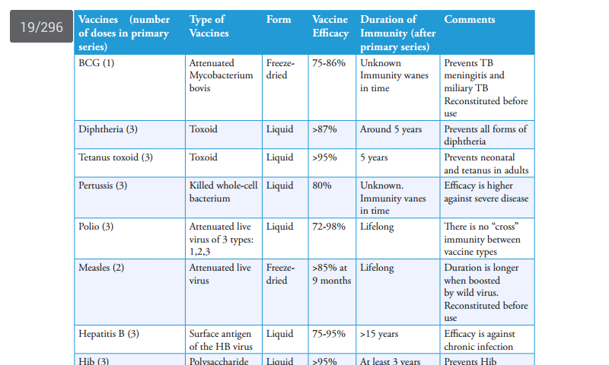

Slide 6
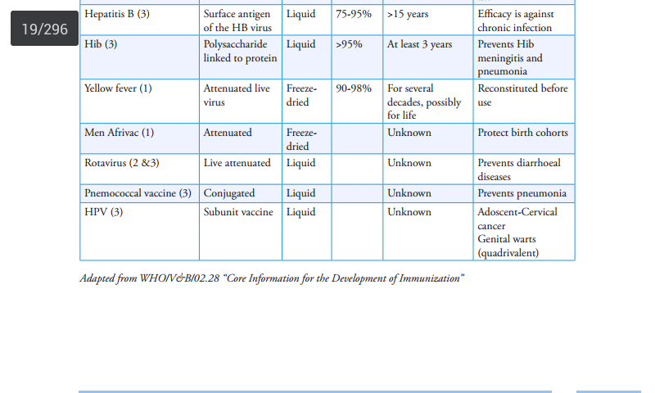

Slide 7
Yellow fever vaccination is still currently only given routinely to children in Baringo and Marakwet districts.
Vitamin A, though not a vaccine is given during growth monitoring and/or vaccination sessions every 6 months till 5 years.
A second dose of measles is now included in the schedule at 18 months of age or at first contact after 18 months for all children.
The first dose between 9 and 12 months of age and the second dose between 18 and 24 months of age.
If a child has missed the first or the second, both doses should be administered up to five years of age maintaining the interval of at least 4 weeks between the doses.

Slide 8
Points to remember
Every effort should be made to complete the primary vaccination on schedule
There are few contraindications to immunization therefore all eligible children should be immunized
Antibodies present in breast milk do not interfere with the take of oral polio vaccines; therefore mothers should be encouraged to continue breast feeding.
If polio birth dose, for some reason was not administered within the first two weeks of life, it should not be administered. One should then wait until the child is six weeks old and then give OPV 1 together with DPT-HepB+Hib1 and PCV as per the schedule.

Slide 9
All vaccines can be given at the same session if needed, but they must be given in separate syringes and sites.
This means that every time a health worker gets into contact with a child, the immunization record of the child should be checked and missing immunizations for which the child is eligible administered.
For instance, if a child is seen for the first time when ten months old, one should give BCG, DPT-HepB+Hib 1, PCV, OPV 1 and measles and ask the mother to come back four weeks later for DPT-HepB+Hib 2,PCV 2 and OPV 2.

Slide 10
Contraindications
Pregnancy
Sero-positive children
Children with immuno-compromised states
Do not give live attenuated vaccines

Slide 11
Contraindications
MMR vaccine is contraindicated in children known to be allergic to eggs because the mumps virus strain is cultured on embryonated chicken eggs.
NB: HIV is not a contraindication for measles in Kenya as the risk of severe measles is worse than the risk of vaccine derived measles in HIV exposed or infected infants.
Give monovalent measles vaccines at 6 and 9 months of age
Also contraindicated in children with a history of severe reaction to a previous dose
Yellow fever vaccine is contraindicated in children less than 6 months and individuals allergic to eggs

Slide 12
Thank you

